Slide 1

Core Overview & COVID-specific Procedures
Snehal Shetye, Rob Mauck

Slide 2
Biomechanics Core – How we operate
Key players:
  Rob Mauck (Director)
    Snehal Shetye (Technical Director)
    Brendan Stoeckl (Research Specialist)
https://www.med.upenn.edu/pcmd/biomechanics.html
Submit project request form
  In reality, most PIs just directly contact Rob/Snehal
Rob and Snehal sit down with client group to review proposed project, feasibility, approach.
Core user has a choice:
  Self-service (you get trained and then test yourself)
  Fee for service (Snehal and Ashley do the project for you)
After getting trained, you get access to Google Calendar for the particular equipment
Remember to cite us in your manuscript:
  Grant number is P30 AR069619

Slide 3
Available Equipment
Instron 5542 (x2)
Instron 5543
Instron 5848 (x2)
Instron ElectroPuls
Instron 8874
Compression MicroTester
Freezing Stage Microtome
Polarizing Scope
Dynamic Cross-Polarized Light Imaging Setup
GisMO (cross-sectional area measurement device)
3D Printer
Software
  MATLAB, GraphPad, SPSS, Abaqus, Trellis, Rhino 3D, QCapture Pro
Milling Machine, Mini-Lathe, Vertical and Horizontal Bandsaws, Soldering and Electrical Equipment

Slide 4
Signing up and Etiquette
Signup on Google Calendar:
  PCMD:<PI Last Name>:<your pennkey>
    Note: McKay does get first dibs on equipment usage
    Generally, you can only access equipment between the hours of 9-5pm
      We can bend the rules for special circumstances
    All hardware is shared among all users, including McKay, so usually allocate extra time for find your fixtures!
Format is important
  We summarize quarterly usage and send invoices to PIs
  Current PCMD Biomechanics core discount: 90%
If there is a scheduling conflict
  Talk to Snehal or email the other person (pennkey is on calendar signup) and ask nicely
Accessing Snehal
  Don’t hesitate to contact me anytime (I am at McKay from 6:30am to 4pm)
  Do remember I have two jobs: Soslowsky Lab and PCMD Biomechanics Core

Slide 5
COVID Instructions
Currently not training any new people outside of McKay
If you have been previously trained:
  Contact Rob/Snehal to indicate your desire to use core equipment
  Finish Research Resumption Training on KnowledgeLink
  Sign up for Penn Open OnePass
  Refer to McKay Phase II Protocols
  Let Snehal know you have completed steps 1-3
    Snehal will send invitation to Google Calendar named “2_Phase II Overflow”
      Not more than 10 signups at a given time
      Ensure someone will be in lab for the period you have signed up
      Make sure to have your own lab coat, safety glasses, and mask (surgical or Penn-provided only)
      Sign up format: PCMD:<PI last name>:<your Pennkey>:<10-digit phone number>
    Sign up on equipment calendar as you do normally
  To use Polarizing Scope, Instron 5543, or Instron 5542b
    Snehal will share bay calendar named “365B: Mechanical Testing:Polarizing Scope”
    Sign up for this calendar and the equipment you are using
    Make sure there are not more than 2 sign-ups for the bay

Slide 6
Introduction
This presentation will cover how to perform an indentation test of cartilage
I will not talk about the theory involved in cartilage mechanics nor will I go through any of the math
See the September 2019 learning lunch: https://www.med.upenn.edu/pcmd/bc-learninglunches.html
  Details on the structure of cartilage in relation to its mechanics
Meloni et al 2017: https://dx.doi.org/10.1089%2Ften.tea.2016.0191
  Modeling of indentation of cartilage in FEBio
Patel et al 2019: https://doi.org/10.1089/ten.tec.2019.0116
  Review paper on methods for mechanical testing of articular cartilage
Moore and Burris 2014: https://doi.org/10.1016/j.jbiomech.2013.09.020 and 2015: https://doi.org/10.1016/j.joca.2014.09.021
  Mathematical model behind this test

Slide 7
Why Indentation Testing?
Allows testing of uneven surfaces
No need to take cores of cartilage – nondestructive
Allows testing at multiple locations across the surface

Slide 8
Multiple ways to indent
Simple Ramp
  Can curve fit with the hertz contact mechanics model and calculate Young’s modulus
  Modulus will be rate dependent
  Does not capture time dependent behavior and the poroelastic response of cartilage
Stress relaxation
  Ramp to a certain displacement and hold until tissue reaches equilibrium
  Useful to capture time dependence of cartilage
Creep
  Hold a certain load, and measure displacement for a set time
  Simplest method of measuring cartilage mechanics considering time dependence

Slide 9
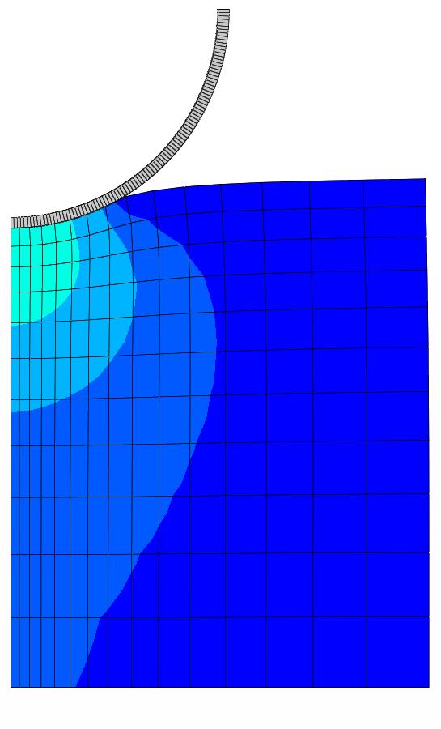
The Creep Indentation Test
Hold material to a constant force, and measure the resulting displacement over time
σ
ε
t
t

Slide 10
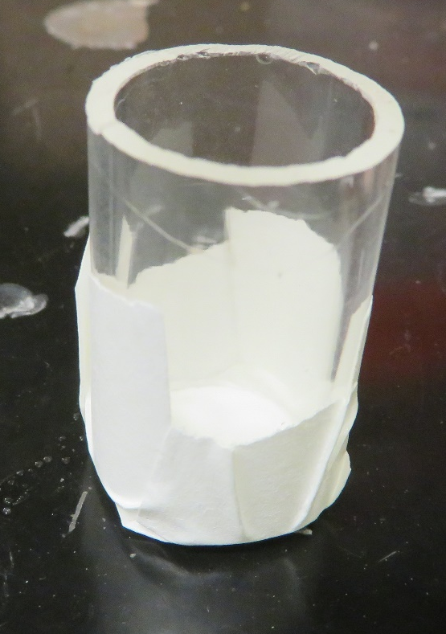
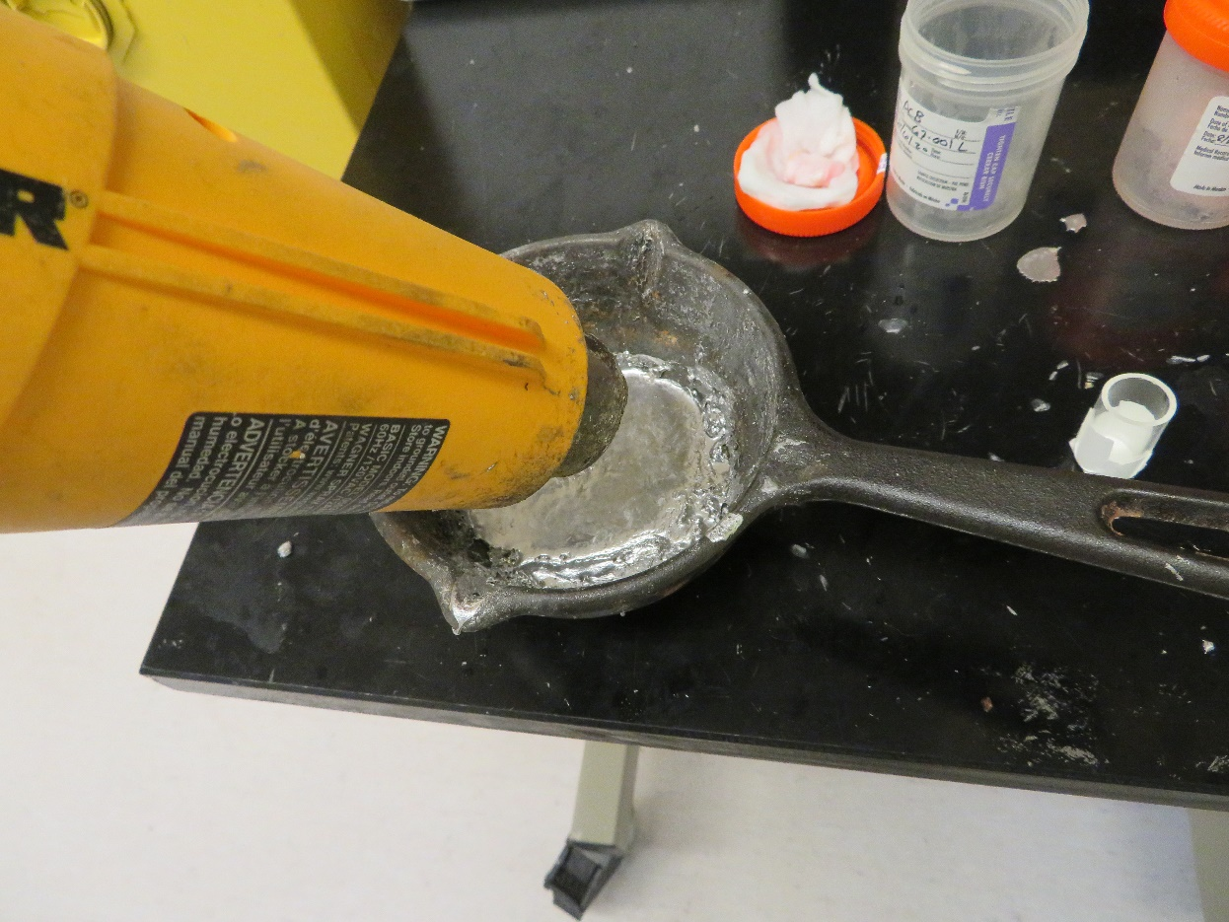
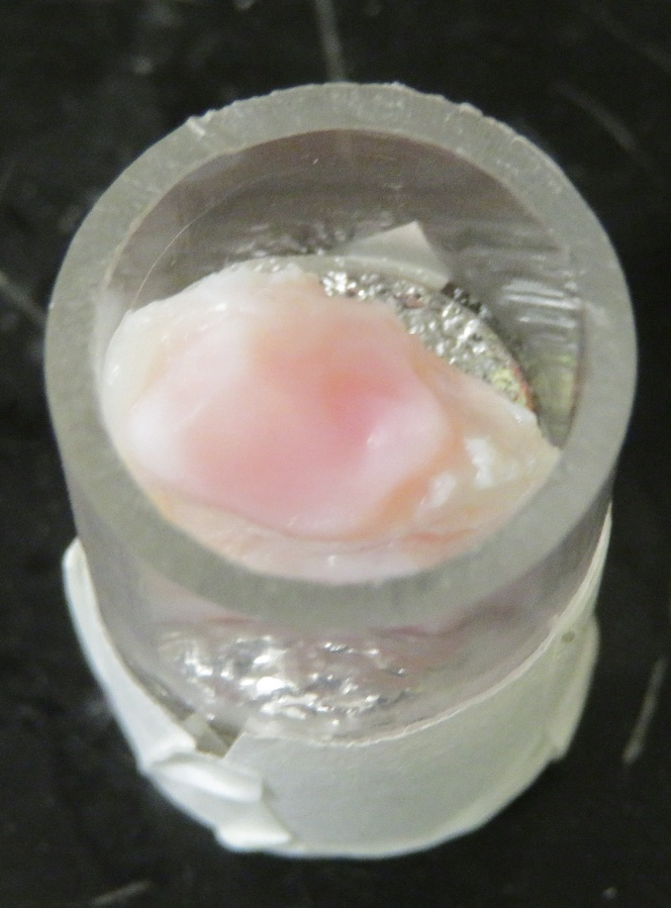
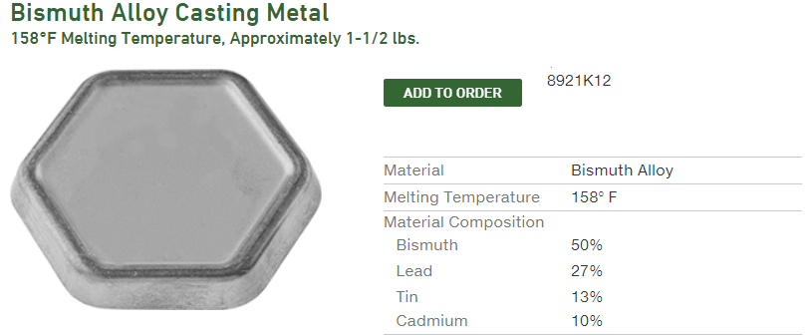
Potting Samples

Slide 11
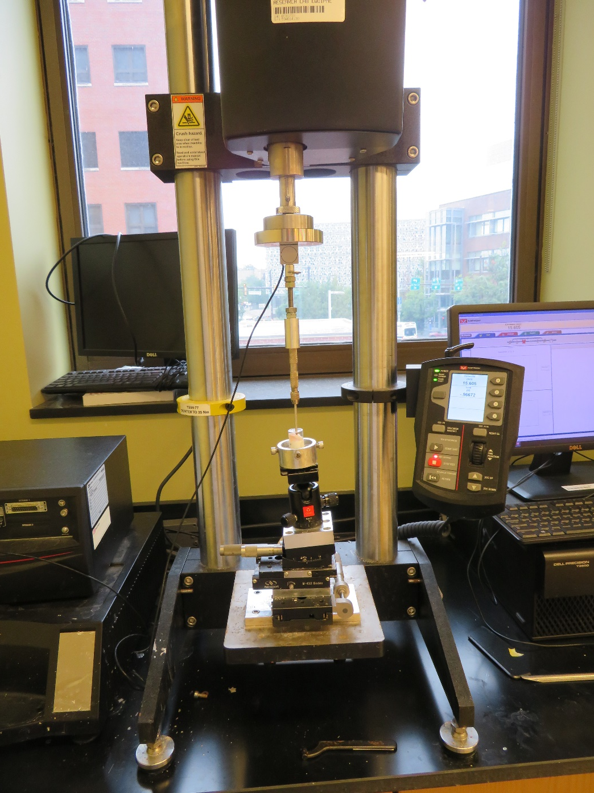
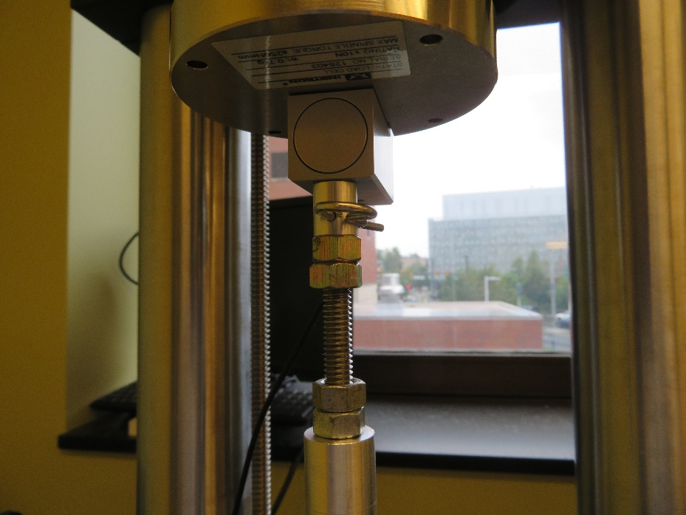
Instron Setup
Load Cell
Indentor with 2mm spherical tip
Rig to position and angle sample

Slide 12
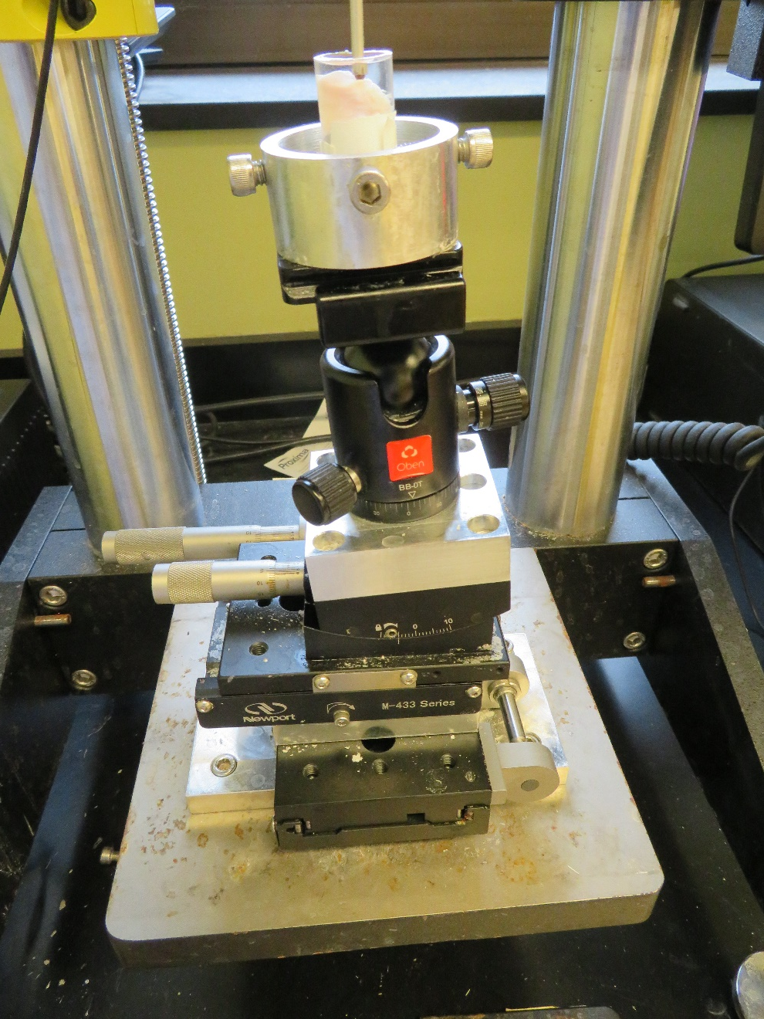
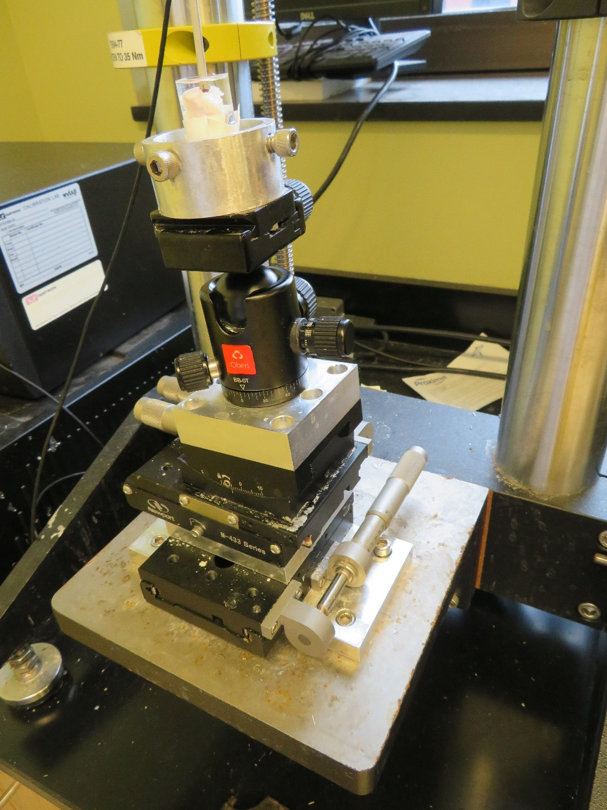
Sample Holder
Specimen Holder
Gross Angle Adjustment
Fine Angle Adjustment
X direction linear stage
Y direction linear stage

Slide 13
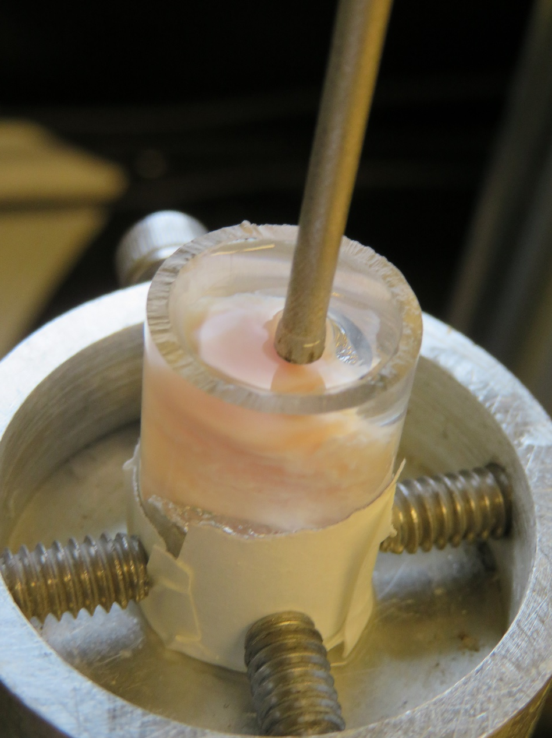
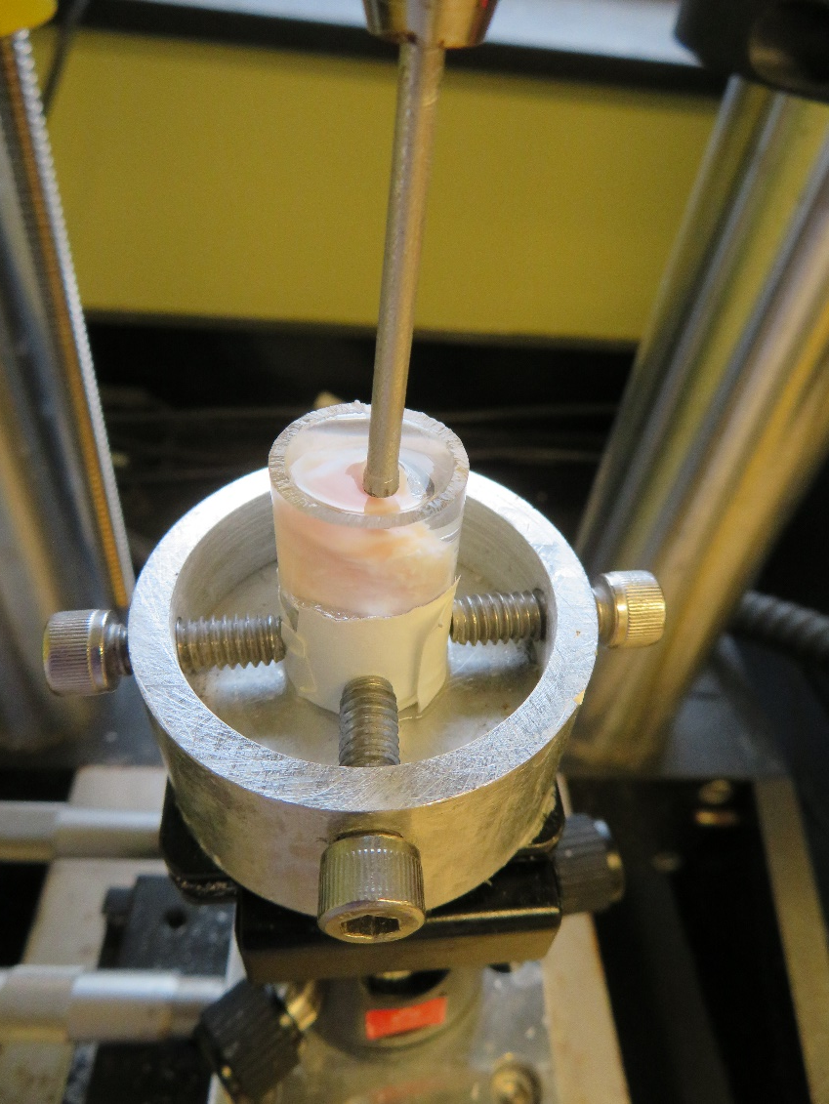
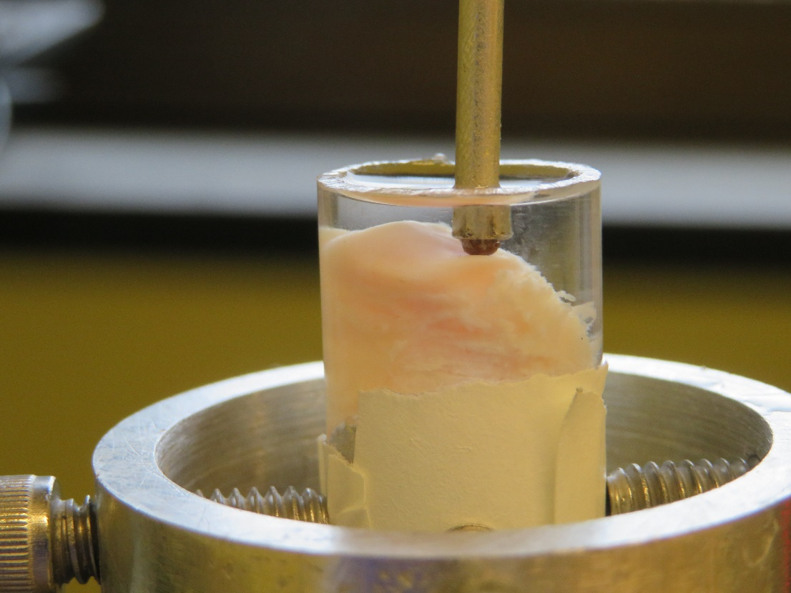
Sample Position

Slide 14
Raw Results

Slide 15
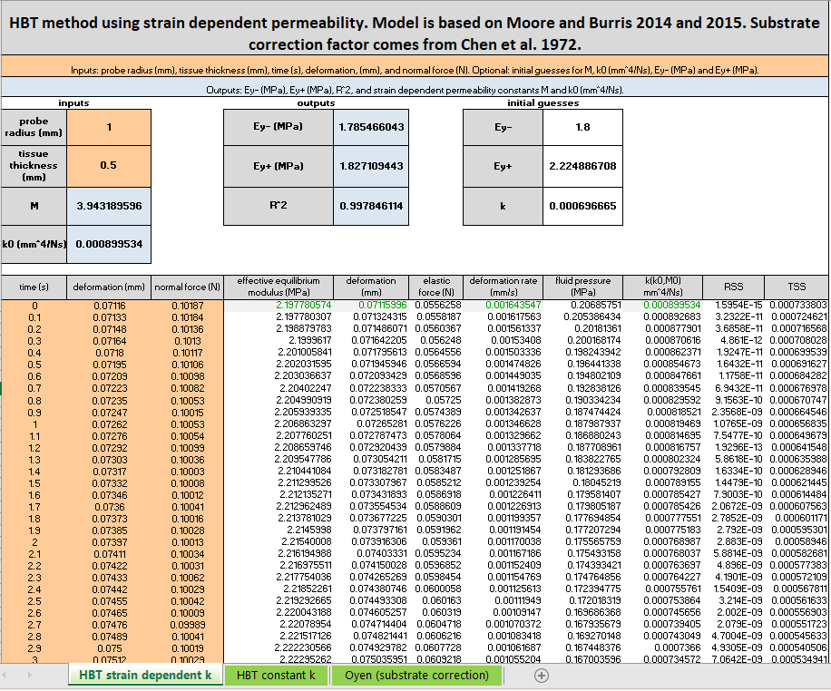
Analysis

Slide 16
Definition of Parameters
M | Strain dependent permeability constant
k₀ | Permeability
E_{y-} | Compressive Modulus
E_{y+} | Tensile Modulus

Slide 17

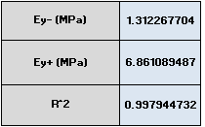
Results of Analysis

Slide 18
Summary
The creep indentation test of cartilage can non-destructively measure the time dependent mechanical properties of cartilage across an uneven surface
For further questions or more information contact Brendan Stoeckl (bstoeckl@pennmedicine.upenn.edu) or Rob Mauck (lemauck@pennmedicine.upenn.edu)

